Slide 1
Crossword Puzzle
Catherine Javadian, Jennifer Cafiero,
And Jordana Approvato

Slide 2
The Problem (Formal)
A Crossword grid is provided to you, along with a set of words (or names of places) which need to be filled into the grid. The cells in the grid are initially, either + signs or - signs. Cells marked with a + have to be left as they are. Cells marked with a - need to be filled up with an appropriate character.

Slide 3
The Problem (Simplified)
Solve a crossword puzzle!

Slide 4
Input
The input contains lines, each with characters (which will be either + or - signs).
After this follows a set of words (typically nouns and names of places), separated by semi-colons (;).

Slide 5
Constraints
There will be no more than ten words. Words will only be composed of upper-case A-Z characters. There will be no punctuation (hyphen, dot, etc.) in the words.

Slide 6
Output
Position the words appropriately in the grid, and then display the grid as the output. So, your output will consist of 10 lines with 10 characters each.

Slide 7
Test Cases
+-++++++++ +-++++++++ +-++++++++ +-----++++ +-+++-++++ +-+++-++++ +++++-++++ ++------++ +++++-++++ +++++-++++ LONDON;DELHI;ICELAND;ANKARA
+-++++++++ +-++++++++ +-------++ +-++++++++ +-++++++++ +------+++ +-+++-++++ +++++-++++ +++++-++++ ++++++++++ AGRA;NORWAY;ENGLAND;GWALIOR

Slide 8
Solutions
+L++++++++ +O++++++++ +N++++++++ +DELHI++++ +O+++C++++ +N+++E++++ +++++L++++ ++ANKARA++ +++++N++++ +++++D++++
+E++++++++ +N++++++++ +GWALIOR++ +L++++++++ +A++++++++ +NORWAY+++ +D+++G++++ +++++R++++ +++++A++++ ++++++++++

Slide 9
The Language

Slide 10
Struggles/Realizations
Struggles:
Dealing with vertical and horizontal words (Added a vertical boolean if true the nextSpace function will increase by row instead of column)
Getting printing to work correctly (Trial and error for almost two hours)
Working:
Modified form of scramble squares

Slide 11
Algorithm Explanation
Uses recursion to go through all possible combinations
Checks if word can fit into the current space, if it can than it adds that word to the spaces and loops back through, working off of the grid with the word added
Returns false from possible combination if no word will fit into a space/if puzzle is filled but there are still words left
Returns true if part of combination will fit and continues to recurse through that possible combination with the remaining words

Slide 12
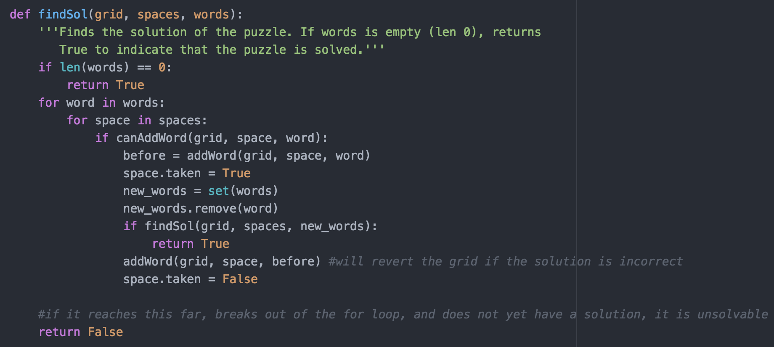
Code Walkthrough (The Good Stuff)

Slide 13
Demo

